Slide 1
Lagrangian Interpolation
by
Dr. Md. Rajibul Islam
CSE, UAP

Slide 2
Lagrange Method of Interpolation

Slide 3
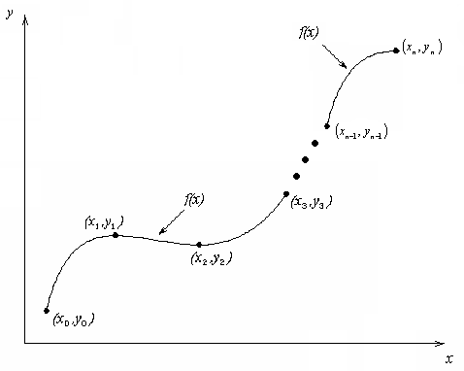
What is Interpolation ?
Given (x₀,y₀), (x₁,y₁), …… (x_{n},y_{n}), find the value of ‘y’ at a value of ‘x’ that is not given.

Slide 4

Interpolants
Polynomials are the most common choice of interpolants because they are easy to:
  Evaluate
  Differentiate, and
  Integrate.

Slide 5
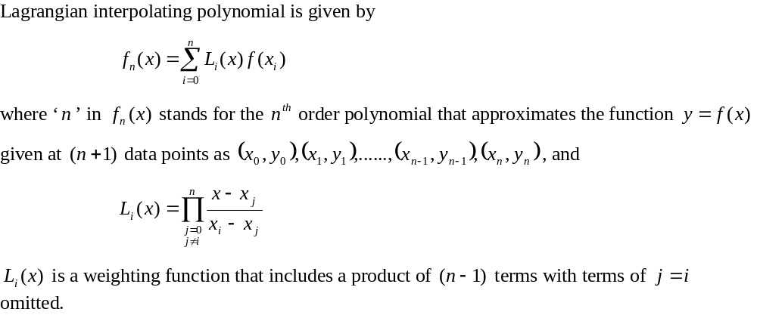
Lagrangian Interpolation

Slide 6
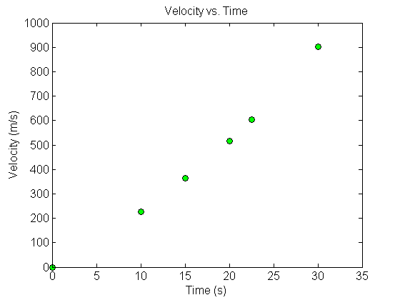



Example
The upward velocity of a rocket is given as a function of time in Table 1. Find the velocity at t=16 seconds using the Lagrangian method for linear interpolation.
Table Velocity as a
function of time
(s) | (m/s)
0 | 0
10 | 227.04
15 | 362.78
20 | 517.35
22.5 | 602.97
30 | 901.67
Figure. Velocity vs. time data
for the rocket example

Slide 7
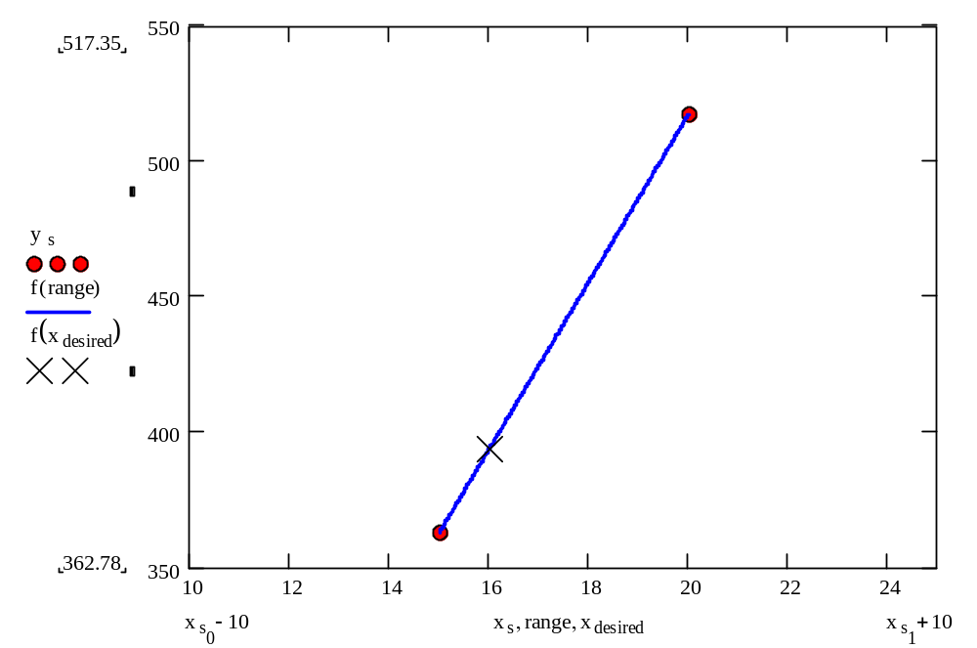
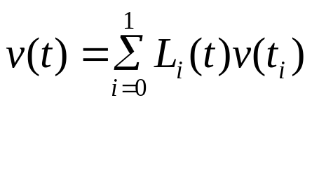

Linear Interpolation

Slide 8
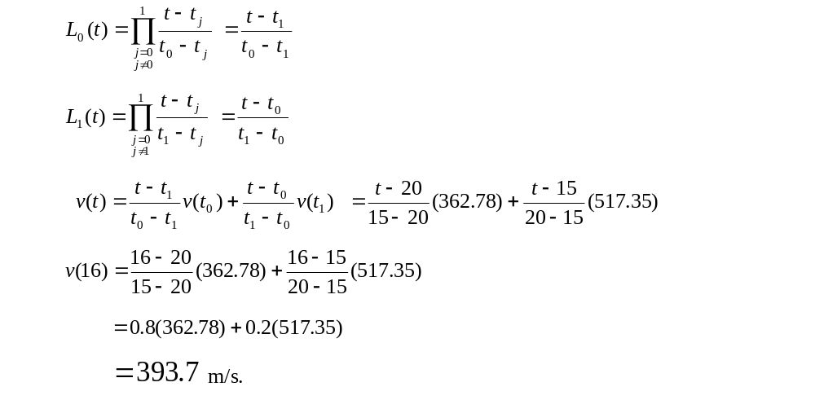
Linear Interpolation (contd)

Slide 9
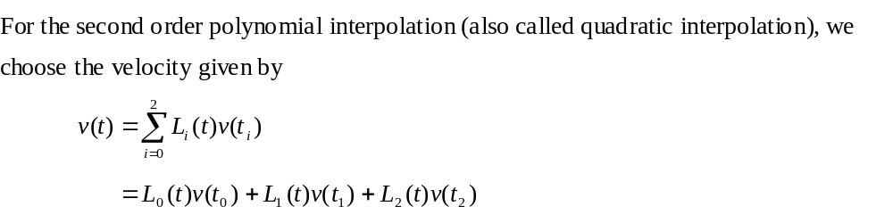
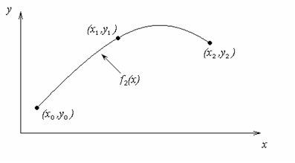
Quadratic Interpolation

Slide 10
Example
The upward velocity of a rocket is given as a function of time in Table 1. Find the velocity at t=16 seconds using the Lagrangian method for quadratic interpolation.
Table Velocity as a
function of time
(s) | (m/s)
0 | 0
10 | 227.04
15 | 362.78
20 | 517.35
22.5 | 602.97
30 | 901.67
Figure. Velocity vs. time data
for the rocket example

Slide 11
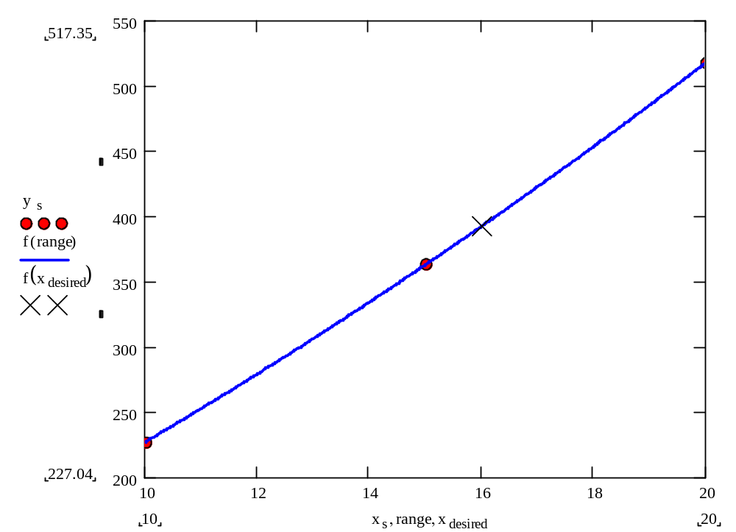
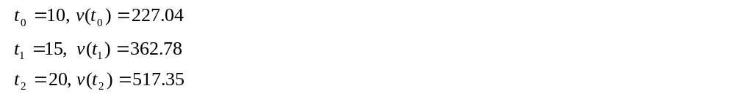
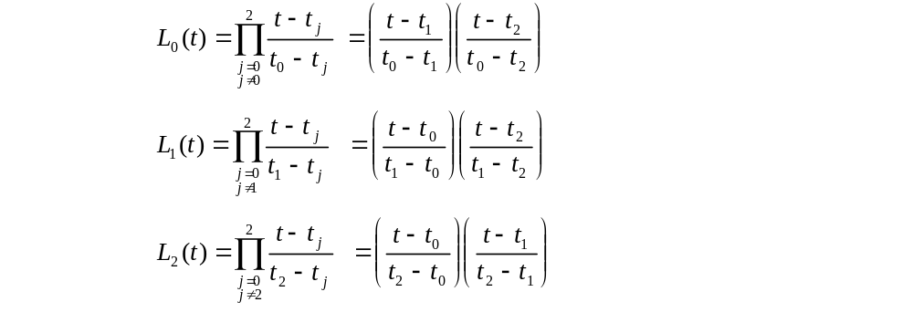
Quadratic Interpolation (contd)

Slide 12
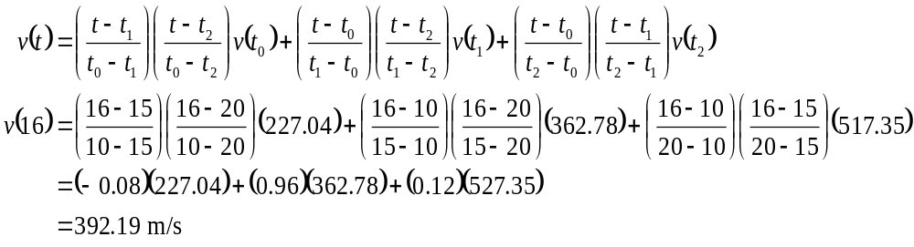

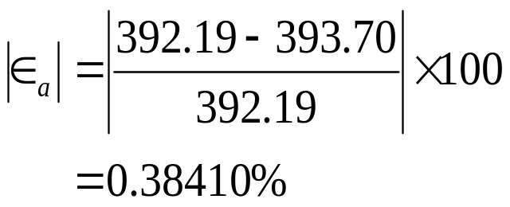
Quadratic Interpolation (contd)
The absolute relative approximate error obtained between the results from the first and second order polynomial is

Slide 13
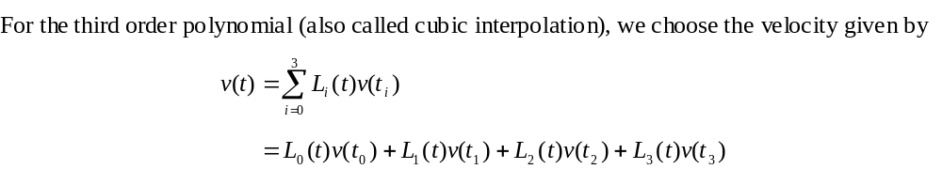
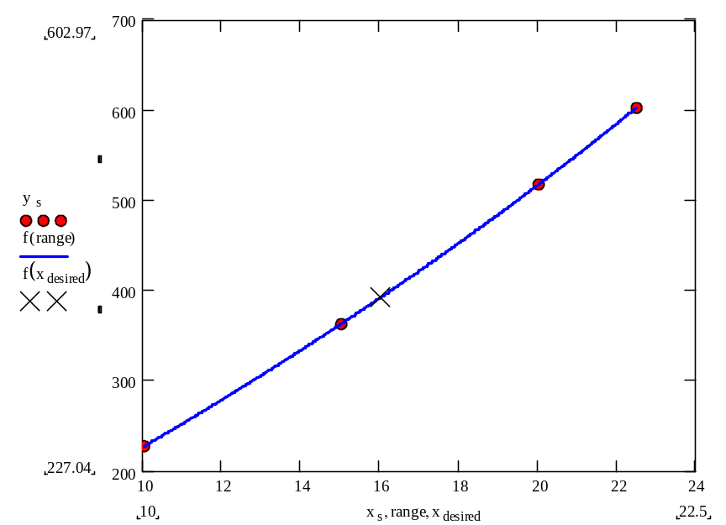
Cubic Interpolation

Slide 14
Example
The upward velocity of a rocket is given as a function of time in Table 1. Find the velocity at t=16 seconds using the Lagrangian method for cubic interpolation.
Table Velocity as a
function of time
(s) | (m/s)
0 | 0
10 | 227.04
15 | 362.78
20 | 517.35
22.5 | 602.97
30 | 901.67
Figure. Velocity vs. time data
for the rocket example

Slide 15
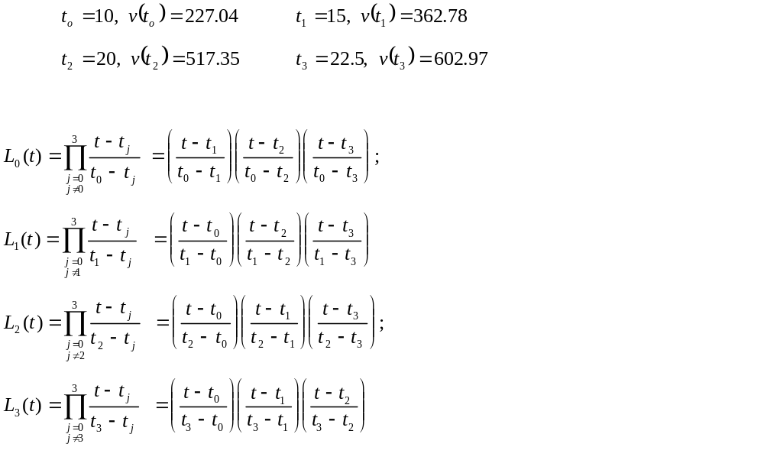
Cubic Interpolation (contd)

Slide 16
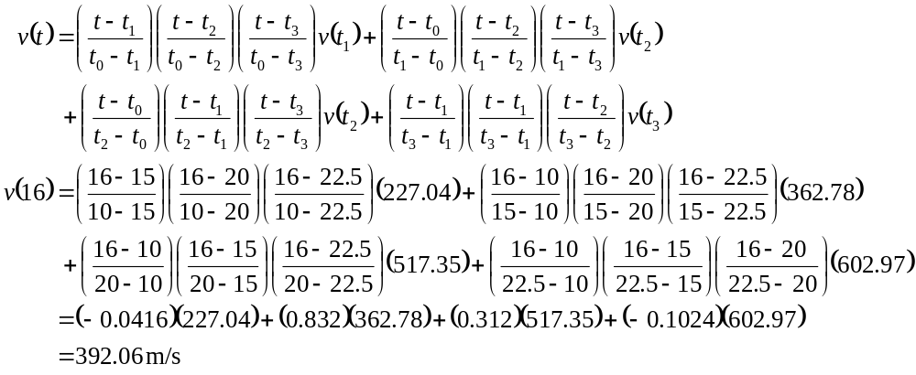
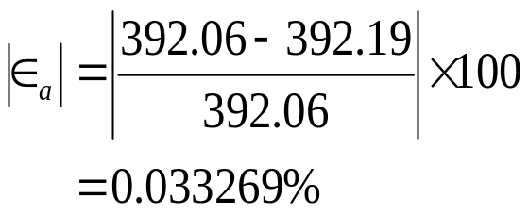
Cubic Interpolation (contd)
The absolute relative approximate error obtained between the results from the first and second order polynomial is

Slide 17
Comparison Table
Order of Polynomial | 1 | 2 | 3
v(t=16) m/s | 393.69 | 392.19 | 392.06
Absolute Relative Approximate Error | -------- | 0.38410% | 0.033269%

Slide 18
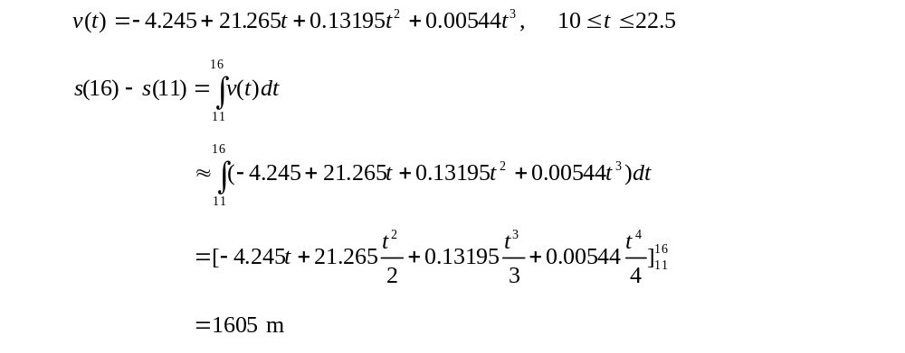
Distance from Velocity Profile
Find the distance covered by the rocket from t=11s to
t=16s ?

Slide 19
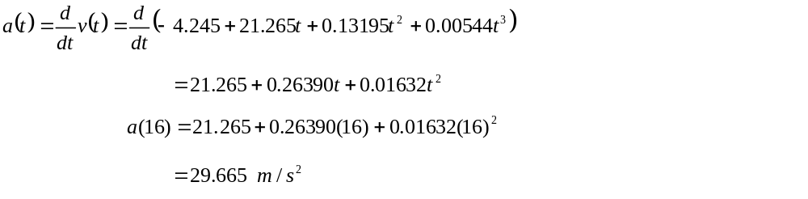
Acceleration from Velocity Profile
Find the acceleration of the rocket at t=16s given that
,

Slide 20
THE END

